Slide 1
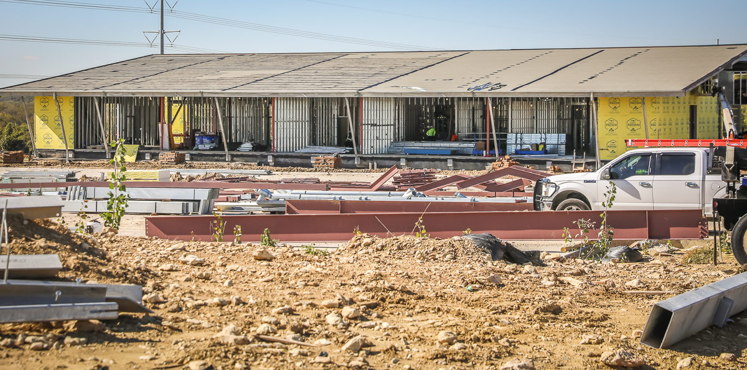
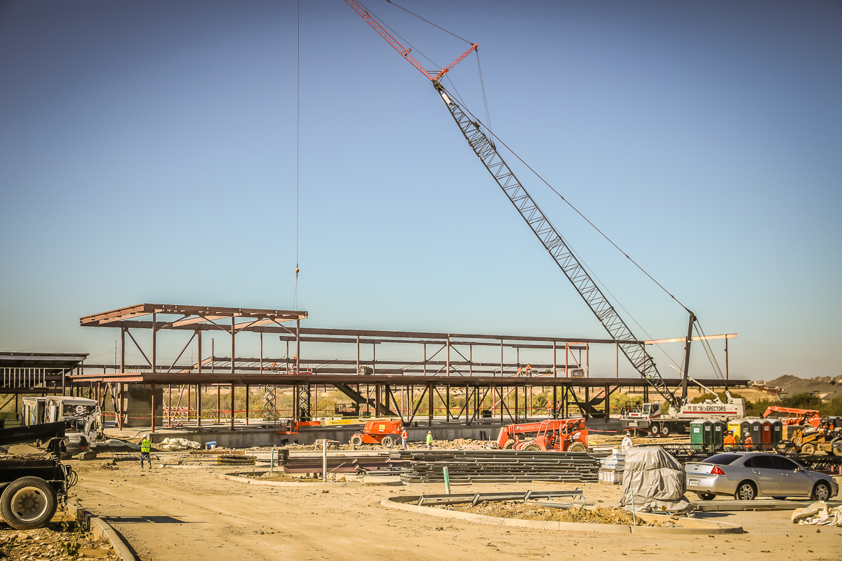
NEW ADMINISTRATION BUILDING
In Area B, the second-floor deck is being completed. The stairs have been installed to the second floor, and the iron work continues in this area.
In Area C, the exterior sheathing, rock work, interior wall framing, and rough-in electrical continues.

Slide 2
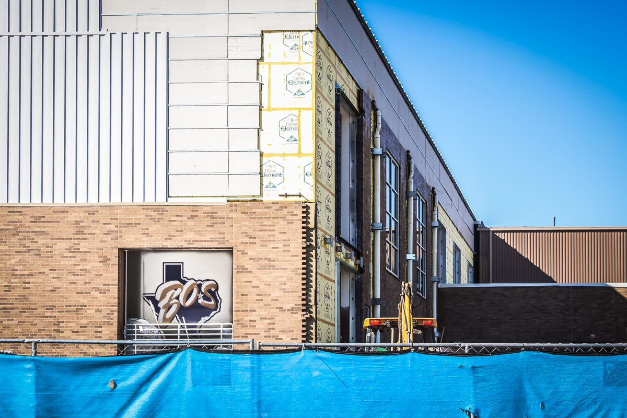
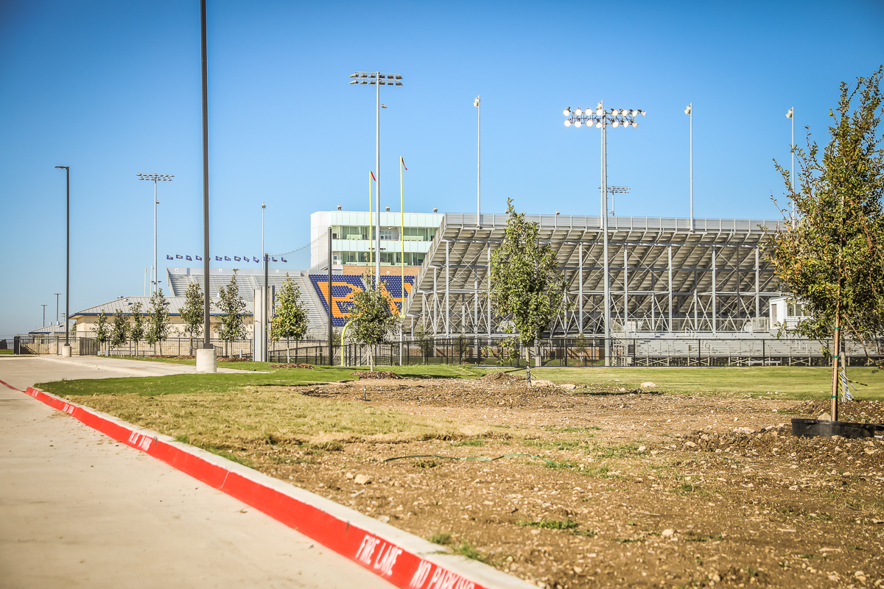
BOSWELL HS
The turf room interior logo has been installed. The north wall construction still continues. Landscaping continues to be planted.

Slide 3
OTHER PROJECTS
Eagle Mountain ES – Cafeteria lighting upgrade is complete, which provides improved photometrics.
Elementary # 18 – Based on demographic projections, the next elementary is needed to relieve Comanche Spring ES. There is tremendous lot development at Bar C, Watersbend South, Todd Tract, and Cranz Farm. The District site is located within Cranz Farm.

